Slide 1
Introduction-Smith's Cricket Academy Case Study
Financial Analysis & Performance Evaluation
About This Presentation
Comprehensive financial analysis of Smith's Cricket Academy and Cricket-4-All shop operations
Period Covered: Year 1 operations (January 1, 2019 onwards)
Prepared for: Strategic business evaluation and performance assessment
What We'll Cover Today
✓ Business Overview - Academy and retail operations structure ✓ Financial Statements - Profit & Loss and Balance Sheet analysis for both entities ✓ Books of Accounts - Complete accounting records and journal entries ✓ Key Performance Indicators - 5 critical metrics for business success ✓ Financial Performance - Profitability, liquidity, and operational efficiency ✓ Strategic Recommendations - Growth opportunities and risk management
Key Questions We'll Answer
How profitable are the academy and shop operations?
What are the cash flow patterns and potential risks?
Which business unit performs better financially?
What KPIs should James monitor for sustained success?
How can the business optimize its financial performance?

Slide 2
Objectives of the Study
Primary Objectives:
Prepare comprehensive books of accounts for Smith's Cricket Academy and Cricket-4-All shop (Year 1)
Develop annual financial statements including Profit & Loss and Balance Sheet for both entities
Identify and analyze 5 Key Performance Indicators (KPIs) to measure business performance and sustainability
Secondary Objectives:
Evaluate financial viability of the dual-business model (Academy + Sports Equipment Shop)
Assess cash flow management and identify potential overdraft risks in either business
Analytical Focus:
Compare performance between Academy (service-based) vs Shop (retail-based) operations
Analyze profitability, liquidity, and operational efficiency metrics
Evaluate James Smith's investment returns and business sustainability

Slide 3
Academy & Shop as Separate Entities
Smith's Business=Academy (Training Division)+Shop (Sports-4-All Division)
Smith’s Cricket Academy
Provides coaching & training services
Income: Student fees
Costs: Rent, coach salary, kits, equipment
Sports-4-All
Sells sports equipment & accessories
Income: Sales + Endorsements
Costs: Lease, furniture, iPad/software, salaries, ads
Why Separate Entities?
Separate P&L + Separate Balance Sheet
Ensures independent financial performance
Avoids mixing revenues and expenses

Slide 4
ACCOUNTING CONCEPTS
Accrual Basis Record money you earned or cost you had during the time it happened, not just when you get or pay cash. The fees paid by students in advance is recorded as money owed for future lessons, not income now.
Matching Principle Match the cost of things like rent and salaries to the time when the academy is running. Groundsman’s salary and rent are recorded for the months the academy was open.
Going Concern Assume the academy and shop will keep working in future years. Assets like the car and shop equipment are spread out (depreciated) over years.
Materiality Record important money matters separately so they aren’t missed. Prize money and sponsorship money are shown separately because they matter.
Prudence Prepare for possible losses by noting expected unpaid fees or unsold kits. Some students may not pay fees, and some sports kits may be sold cheap or wasted.

Slide 5
ACCOUNTING ADJUSTMENTS
Accrued Expenses Record costs not paid yet but already used. Salaries or rent owing at the end of the year.
Deferred Income (Money Received Early) Money you got but haven’t earned yet. Money received as fees for future training, recorded as a liability.
Depreciation (Wear and Tear) Spread cost of big things like car and shop items over their life. The car’s price is divided over years; every year some cost is recorded.
Prepaid Expenses Money you paid early, but use over time. Insurance paid for the shop in advance, recorded bit by bit each month.
Bad Debt Allowance Plan for some money you might not get back. Five students unable to pay their fees, so estimate this loss now.
Inventory Write-offs Remove or reduce value of old or unsold goods. Unsold cricket kits either sold cheap or discarded, adjusted in accounts.

Slide 6
Key Transactions(Academy):
Rented land + shed from local school:
Rent: 1,500 per month, payable quarterly in advance.
Refundable deposit: 1,000.
Purchased cricket equipment worth 10,000.
Hired a groundsman at 500/month salary, payable at month-end .
Monthly expenses:
Electricity, water, telephone, balls, stumps, lights etc.
30 students enrolled:
Normal fee: 1,600 per year per student, payable quarterly.
Discount: 10 seats offered to local school → fee reduced by 1,000 total

Slide 7
Key Transactions(shop):
1. Initial Setup / Capital Investment
Fixtures, IT, and Inventory: AUD 45,000 (funded via bank)
Computer: AUD 3,000
iPad: AUD 4,500
Total Setup Investment: AUD 52,500
2. Purchases
Stock purchases: AUD 19,000 (paid via creditors/bank)
3. Sales
Shop sales revenue: AUD 20,000 (cash/bank received)
4. Expenses
Staff Salaries: AUD 350 (monthly)
Utilities & Bills: AUD 80 (monthly)
Insurance: AUD 1,500 (one-time, paid via bank)

Slide 8
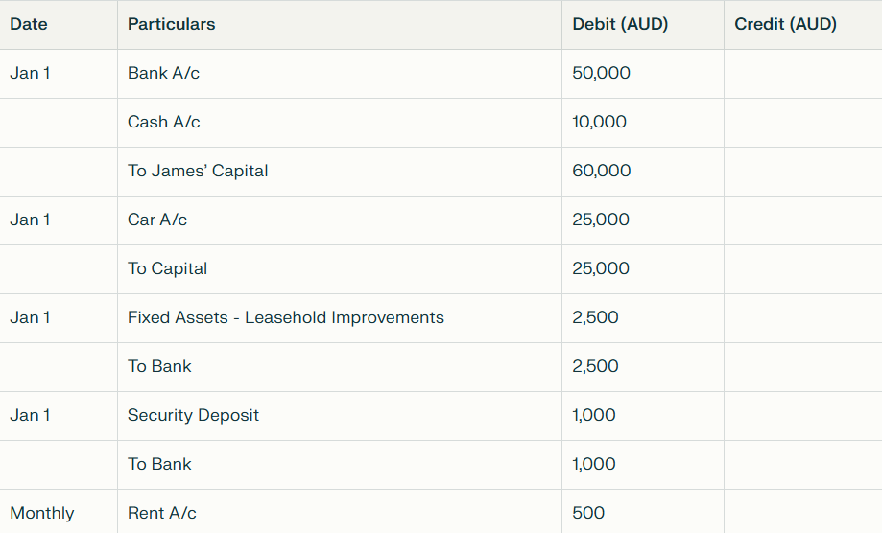
Balance Sheet (Academy)

Slide 9
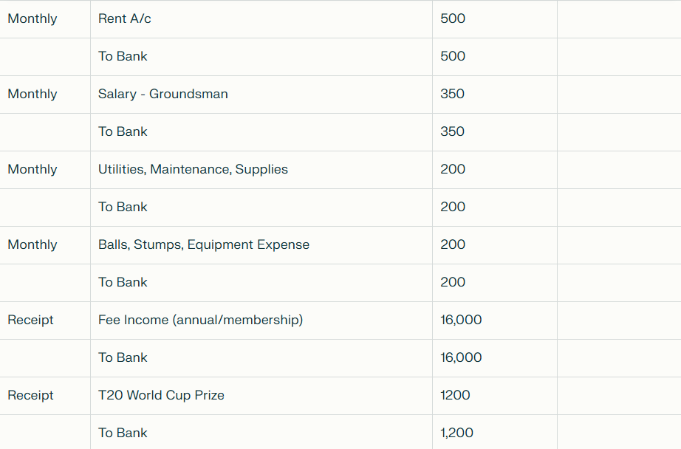

Slide 10
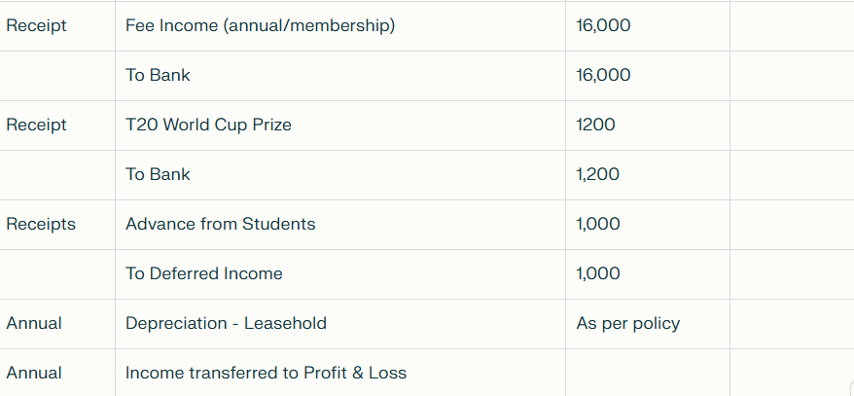

Slide 11
Profit & Loss
.

Slide 12
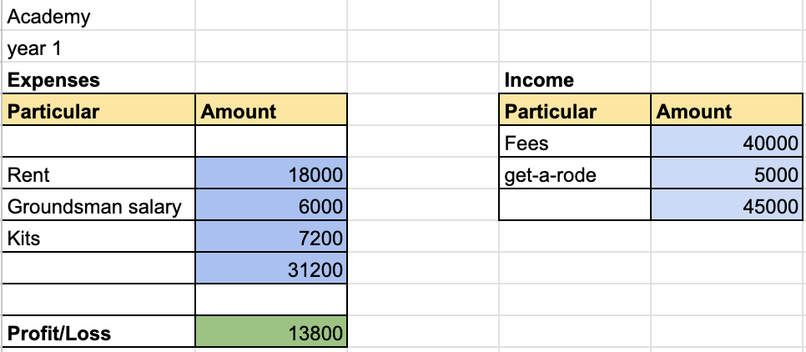
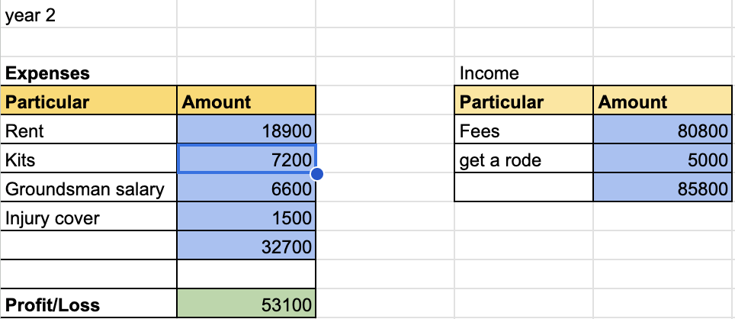

Slide 13
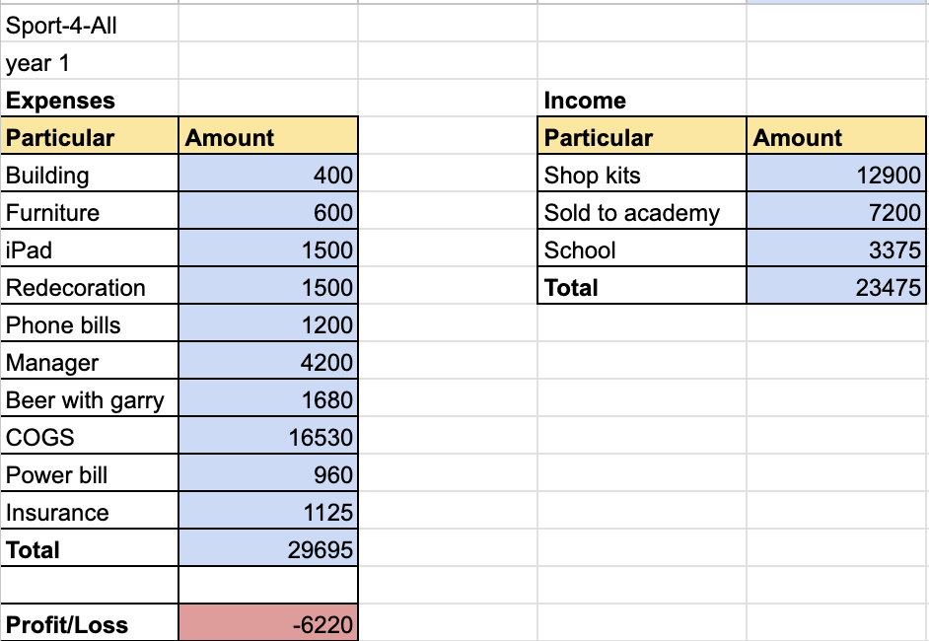

Slide 14
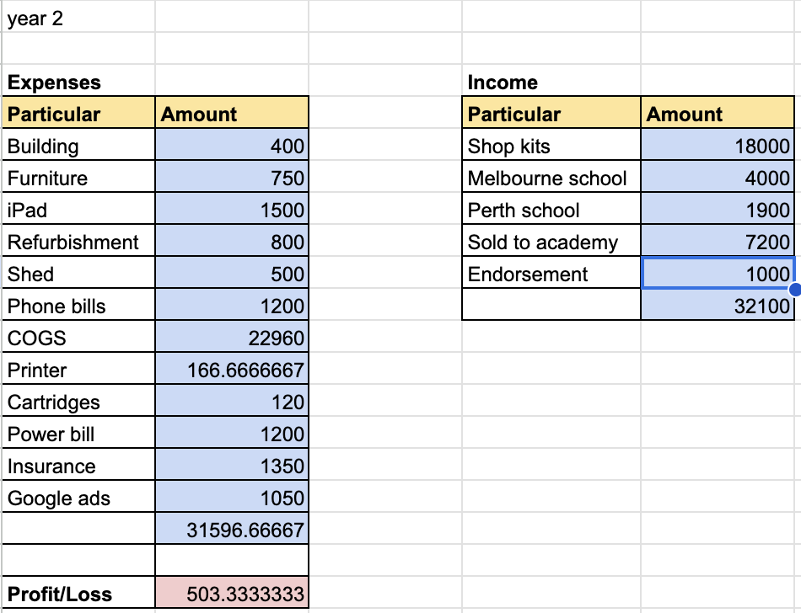

Slide 15
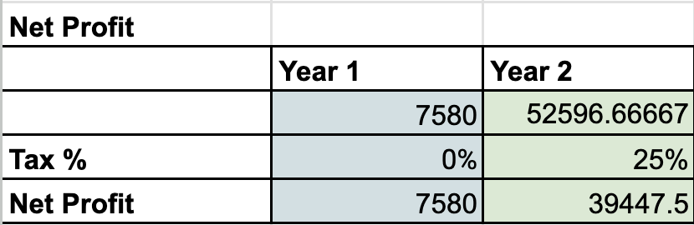

Slide 16
Performance Analysis

Slide 17
Consolidated view
Year 1 (after tax = 0%): Net Profit 7,580 on Revenue 68,475 ⇒ Net Margin 11.07%
Year 2 (after tax 25%): Net Profit 40,203.25 on Revenue 117,900 ⇒ Net Margin 34.12%
What the numbers say
Academy is the profit engine.
Explosive top-line growth (+90.7%) and strong operating leverage: expenses rose ~4.8% while revenue nearly doubled.
Even after 25% tax, net margin jumped from 30.7% → 46.4%.
Shop turned around to breakeven.
From −26.5% to +1.2% net margin. It’s a thin profit after tax, but the direction is right. Revenue grew ~36.8% with limited expense growth (~6.4%).
Tax impact matters but is outweighed by scale.
Despite moving from 0% to 25% tax in Year 2, consolidated profitability soared due to the Academy’s growth and the Shop’s near-breakeven.

Slide 18
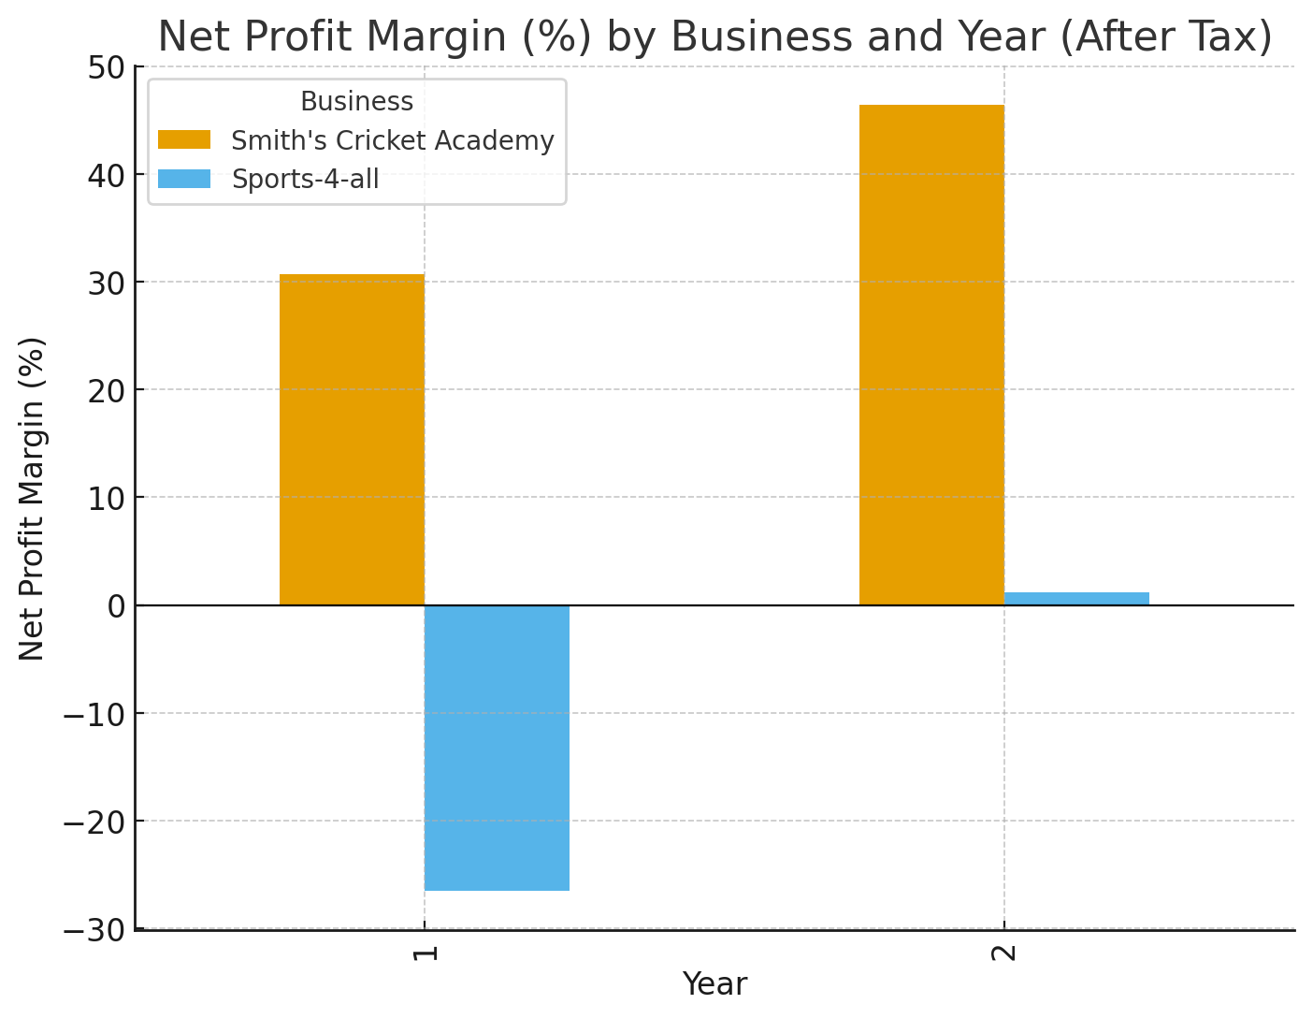

Slide 19
Conclusion
Smith’s Cricket Academy is the main profit driver with strong growth.
Sports-4-All shop is improving and moving towards financial stability.
Proper use of accounting concepts and adjustments ensured reliable analysis.
The dual-business model is viable with better cash flow and inventory management.
Monitoring KPIs such as liquidity, profitability, and efficiency is essential for long-term success.
The case proves that small enterprises can succeed with structured financial planning.

